Slide 1

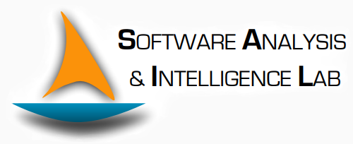
Neurosymbolic programming
—— Brief Review and Case Study ——
PhD student: Zhimin Zhao
Date: 9/4/2022

Slide 2
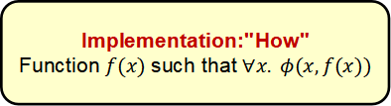
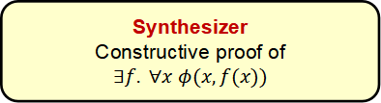
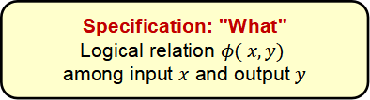
Program Synthesis
f(x) is recognized as always or sometimes correct.
Specification: "What"
Logical relation $φ( x,y)$
among input $x$ and output $y$
Definition:
construction of programs from user intent
Based on Specification:
deductive
inductive
natural language-based
Counterpart:
synthesis: explicit return a program.
induction: learn to mimic the program.
Synthesizer
Constructive proof of
$∃f. ∀x$ $φ(x,f(x))$
Implementation:"How"
Function $f(x)$such that $∀x. φ(x,f(x))$
Notes:
Deductive synthesizers use specific descriptions or algorithms in generating programs.
Inductive program synthesis uses inductive reasoning on generating programs out of this specification. Programming by examples (PBE) method comes under this type. The specification can be a set of exemplary data used as input and output.
In natural language-based, normal English sentences are given as specifications. The synthesizers use artificial intelligence to synthesize programs.
synthesis: The black box produces P and allows you to see its mechanics.
induction: The black box produces P but you cannot tell what the mechanics of the program are.

Slide 3
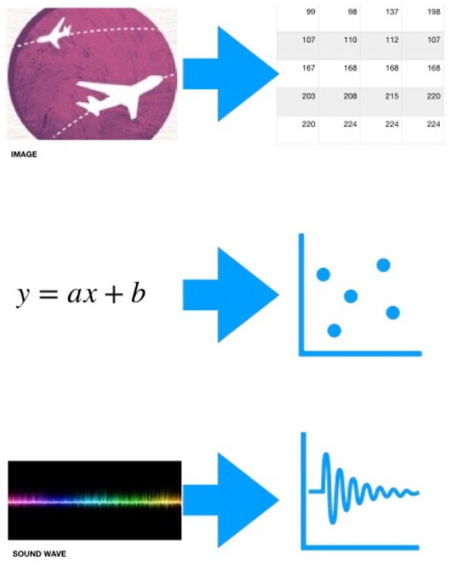



Representation Learning
Machine learning is the study of computer algorithms that can improve automatically through experience and by the use of data (Mitchell, 1997).
Representationalism is the view that representations are the main way we access external reality.
Representation learning is a class of machine learning approaches to learn compact, numerical representations for signals (Bengio, 2013).
Notes:
When we say "representation learning," deep or not, we mean machine learning in which the goal is to learn to transform data from its original representation to a new representation that retains information essential to objects that are interesting to us, while discarding other information.

Slide 4
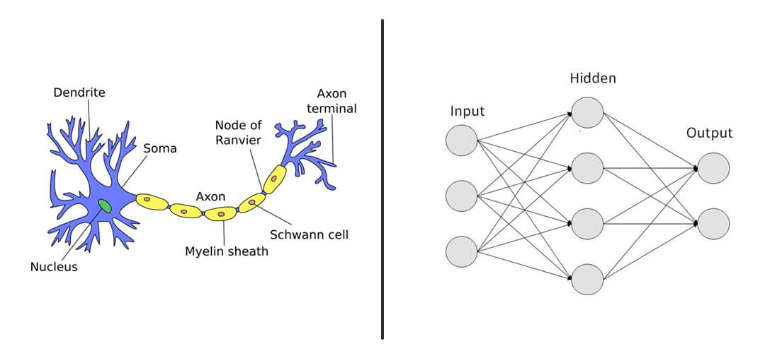
Neural network
Neural network is a computing system with interconnected nodes that work much like neurons in the human brain (Hopfield, 1982).
Deep learning is a subfield of representation learning, and neural networks make up the backbone of deep learning algorithms (Garson).

Slide 5
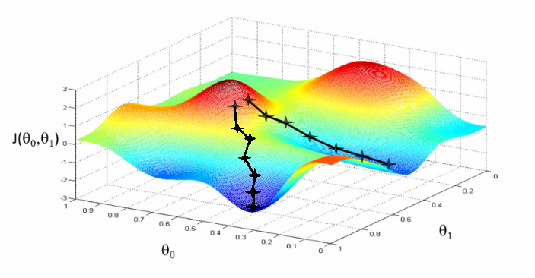
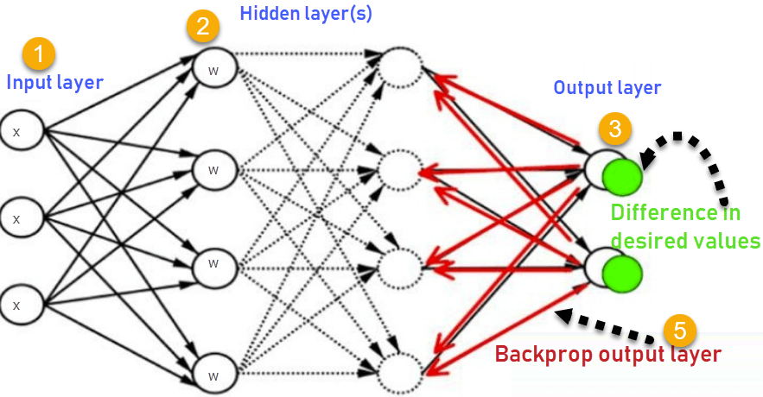
Backpropagation
“Backward propagation of errors" is an algorithm for supervised learning of artificial neural networks using gradient descent (Goodfellow, 2016).
Gradient descent is a first-order iterative optimization algorithm for finding a local minimum of a differentiable function (Lemaréchal, 2012).

Slide 6
Paradigm Comparison
Deep Learning
System 1 thinking: intuitive, fast, unconscious
Interpretability
Hard to understand the results of deep learning models.
Reusability
Nearly impossible to assign responsibility for a network’s capabilities to specific layers.
Data efficiency
Must learn even the most basic forms of human-held knowledge from data.
Concept drift
Values of hidden variables change over time.
Sparsity
Excels at domain where input space is continuous
Symbolic AI
System 2 thinking: slow, logical, algorithmic
Expressiveness
Difficult to capture the world entirely using rules and logic.
Rationalism
Have no mechanism to handle sensory inputs
Fragile to noise
Scalability
Discrete reasoning is an NP-hard problem
Deep knowledge
Highly dependent on hand-crafted semantics to guide the program generation.
Notes:
Concerns remain about the use of neural networks in real-world problem domains (Marcus and Davis, 2019).
Interpretability: Neural networks are black boxes for most practical purposes.
Reusability: While modern neural networks are obtained through the composition of many layers, it is nearly impossible to assign responsibility for a network’s capabilities to specific layers. This makes it difficult to reuse components of a network in the way that is possible for traditional, human-written software.
Data efficiency: Training process for neural networks is entirely data-driven and must learn even the most basic forms of human-held.
Concept drift: Results depend on low-level facets of the training environment, and the networks they learn can fare poorly on inputs that fall even slightly outside the training distribution.
Expressiveness: capturing the world entirely using rules and logic proved difficult, not least because it was difficult to model uncertain and ambiguous knowledge in such notations.
Rationalism: classical symbolic methods did not have a mechanism to handle sensory inputs.
Scalability: Discrete reasoning is an NP-hard problem, and algorithms for tasks such as planning and theorem-proving could only scale so far.

Slide 7
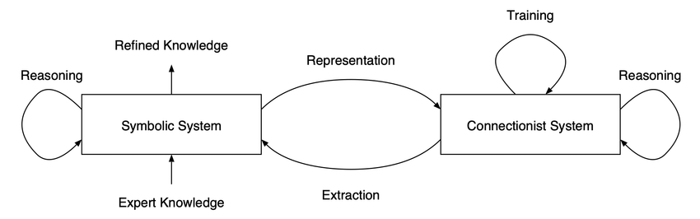
Neurosymbolic programming
Definition:
A body of methods that synthesize programs that combine both neural and program-like logical components (Chaudhuri, 2021).
Feature:
The model fits a given dataset approximately and generalizes to unseen inputs.
Model:
PLANS (Dang-Nhu, 2020), Bayou (Murali, 2018), HOUDINI (Valkov, 2018), NSPS (Parisotto, 2017), Robustfill (Devlin, 2017), SSC (Devlin, 2017), etc.
Notes:
Neurosymbolic programming is an emerging area that bridges the areas of deep learning and program synthesis.
As in classical machine learning, the goal is to learn functions from data. However, these functions are represented as programs that can use neural modules in addition to symbolic primitives and are induced using a combination of symbolic search and gradient-based optimization.
For example, the figure illustrates a few examples of the kinds of compositions of neural and logical components that a nesy-framework will handle.

Slide 8
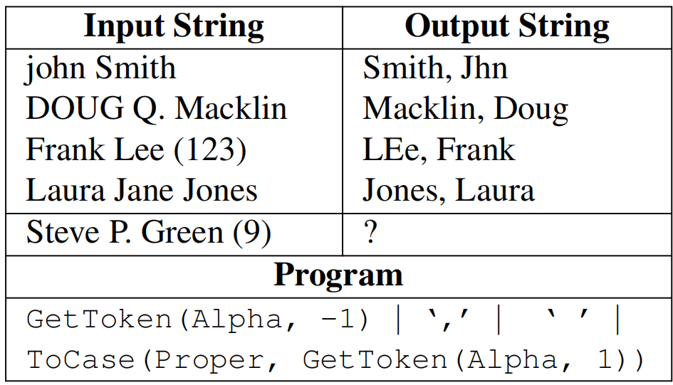
RobustFill (ICML 2017) -- Problem Statement
The goal of the task is to fill in the blank (i.e., ‘?’ =‘Green, Steve’).
An anonymized example from FlashFillTest (Singh, 2015) with noise (typos).
Notes:
The primary task evaluated for this work is a Programming By Example (PBE) system for string transformations similar to FlashFill.
A user manually provides a small number of example output strings to convey the desired intent and the goal of FlashFill is to generalize the examples to automatically generate the corresponding outputs for the remaining input strings.
FlashFill allows Microsoft Excel end-users to perform regular expression-based string transformations using examples without having to write complex macros.

Slide 9
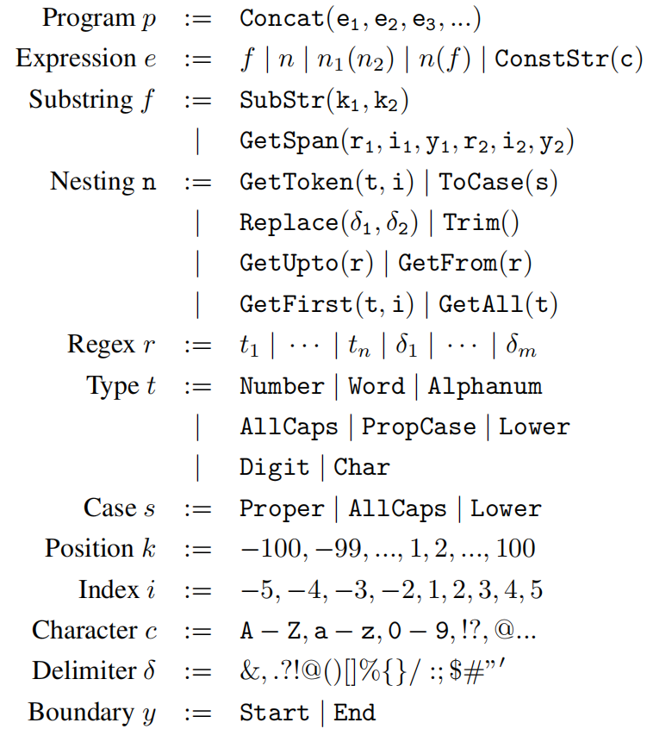
Domain Specific Language
To pepresent program a rich set of string transformations based on substring extractions, string conversions, and constant strings.
Notes:
For program representation, we have developed a domain-specific language (DSL) that defines an expressive class of regular expression-based string transformations.

Slide 10
Training & Test Data
Training dataset:
FlashFill (~175 instances) (Singh, 2015)
random sampling: from DSL, up to a maximum length (10 expressions).
constraint injection: compute a set of heuristic requirements on the input string such that the program can be executed smoothly.
Evaluation dataset:
FlashFillTest (~205 instances)
Each instance has 10 I/O examples (4 observed, 6 assessment)
Notes:
Since there are only a few hundred real-world FlashFill instances, the data used to train the neural networks was synthesized automatically.
To do this, we use a strategy of random sampling and generation.
First, we randomly sample programs from our DSL, up to a maximum length (10 expressions).
Given a sampled program, we compute a simple set of heuristic requirements on the InStr such that the program can be executed without throwing an exception.
For example, if an expression in the program retrieves the 4th number, the InStr must have at least 4 numbers.
Then, each InStr is generated as a random sequence of ASCII characters, constrained to satisfy the requirements.
The corresponding OutStr is generated by executing the program on the InStr.
For evaluating the trained models, we use FlashFillTest, a set of 205 real-world examples collected from Microsoft Excel spreadsheets

Slide 11
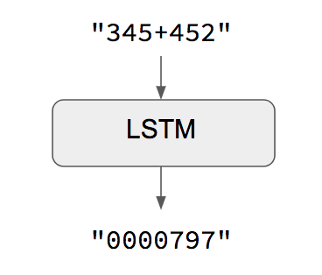
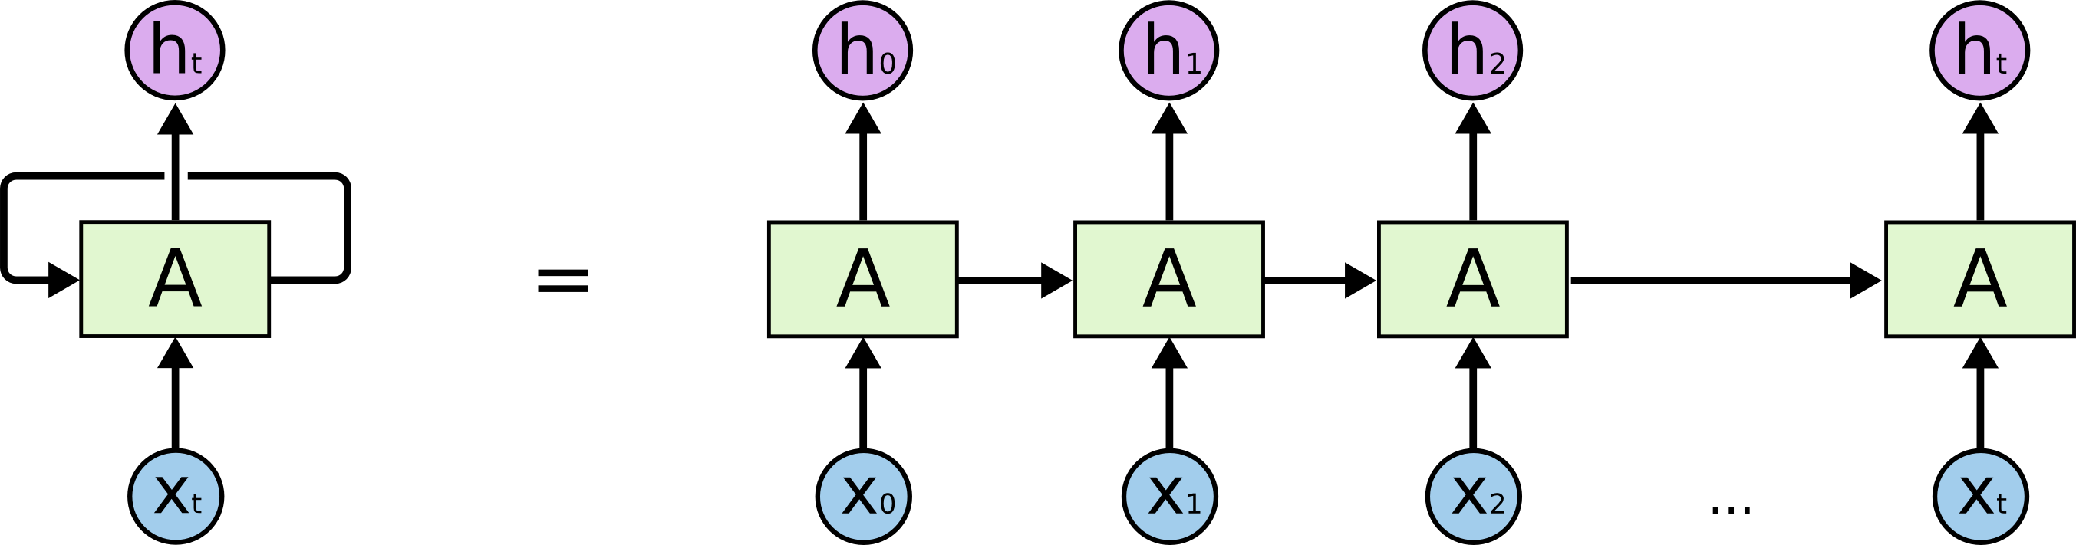
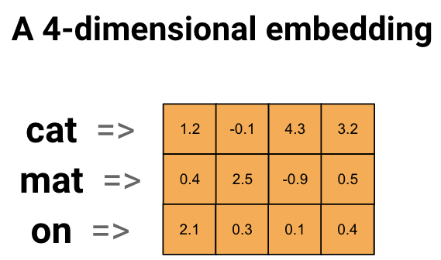
Model Goal
Program synthesis is modeled as a sequence-to-sequence generation task.
Vocabulary: 430 tokens
Goal: maximize the log-likelihood of the reference programs.
The model encodes the observed I/O using a series of recurrent neural network (RNN), and generate program using another RNN one token at a time.
Notes:
We model program synthesis as a sequence-to-sequence generation task.
Sequence-to-sequence learning (Seq2Seq) is about training models to convert sequences from one domain (e.g. sentences in English) to sequences in another domain (e.g. the same sentences translated to French).
In all cases, the InStr and OutStr are processed at the character level, so the input to I and O are character embeddings. The vocabulary consists of all 95 printable ASCII tokens.
The inputs and targets for the P layer is the source-code order linearization of the program.
The vocabulary consists of 430 total program tokens, which includes all function names and parameter values, as well as special tokens for concatenation and end-of-sequence.
Note that numerical parameters are also represented with embedding tokens. The model is trained to maximize the log-likelihood of the reference program P.

Slide 12
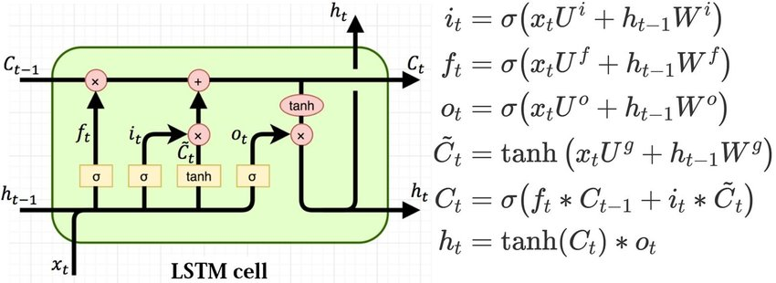
Long Short Term Memory (LSTM)
LSTM network is an instantiation of RNN.

Slide 13
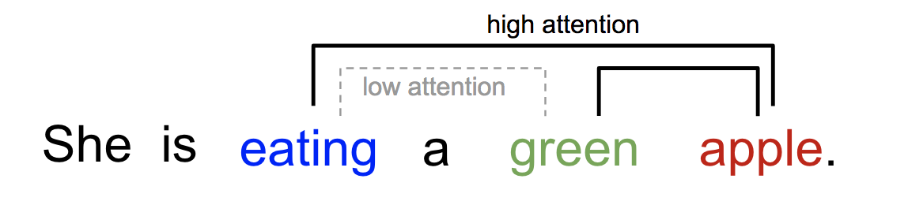
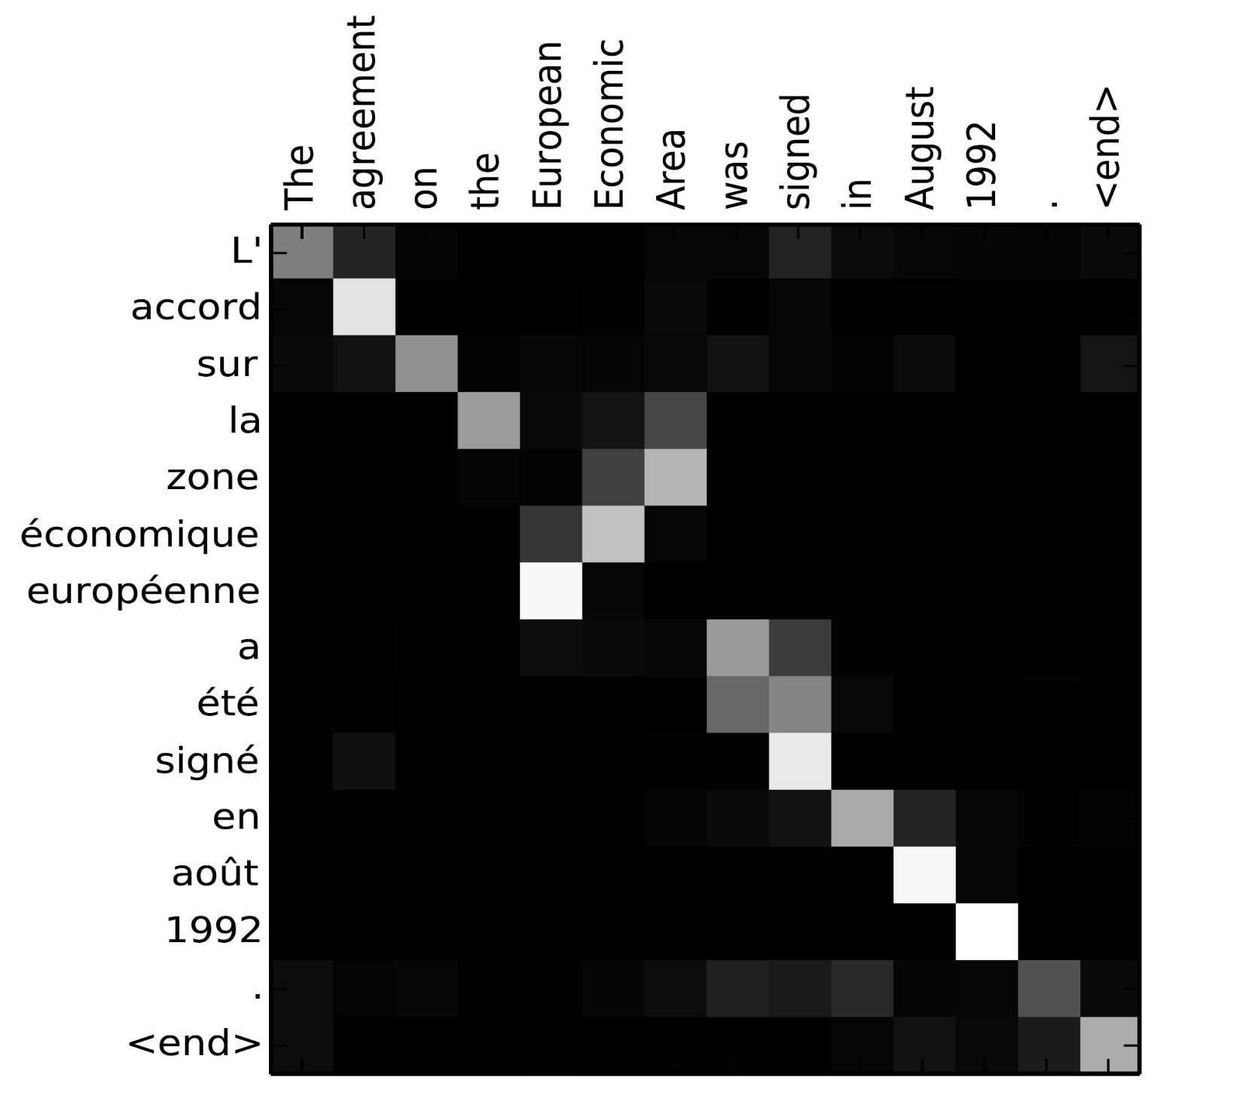
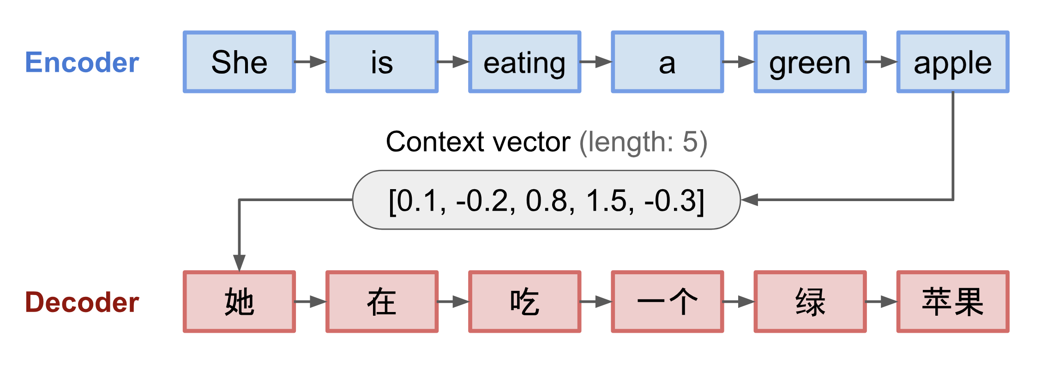
Attention Mechanism
In neural networks, attention is a technique that mimics cognitive attention (Vaswani, 2017).
Attention enhances some parts of the input data while diminishing other parts.
Notes:
Attention Mechanism does very much like humans do when we do try to translate some sentence from one language to other.
We tend to pay more attention to some words in a sentence that other words.
One word "attends" to other words in the same sentence differently.
The encoder-decoder model, translating the sentence "she is eating a green apple" to Chinese. The visualization of both encoder and decoder is unrolled in time.

Slide 14
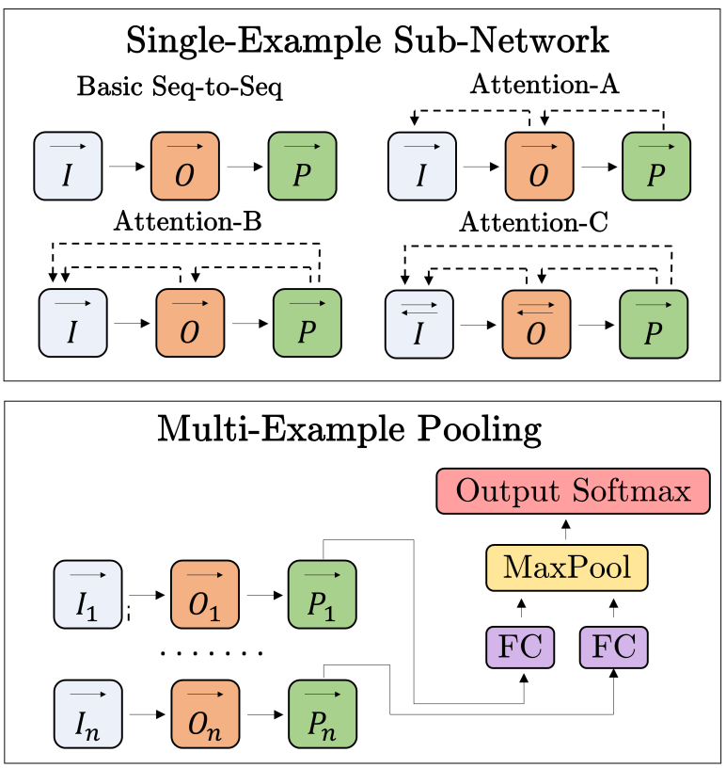
Model Architecture
Single-Example Representation:
Basic Seq-to-Seq
Attention-A
Attention-B
Attention-C
Multi-Example Pooling:
Late Pooling
Hyperparameters & Training:
512 layers
128-d embedding
2 million minibatch (128 instances) update
24h - 2 Titan X GPUs
Notes:
Basic Seq-to-Seq: Each sequence is encoded with a non-attentional LSTM, and the final hidden state is used as the initial hidden state of the next LSTM.
Attention-A: O and P are attentional LSTMs, with O attending to I and P attending to O.
Attention-B: Same as Attention-A, but P uses a dou_x0002_ble attention architecture, attending to both O and I simultaneously.
Attention-C: Same as Attention-B, but I and O are bidirectional LSTMs.
The previous section only describes an architecture for encoding a single I/O example.
Each I/O example has its own layers for I, O, and P (with shared weights across examples), but the hidden states of P1, ..., Pn are pooled at each timestep before being fed into a single output softmax layer.

Slide 15
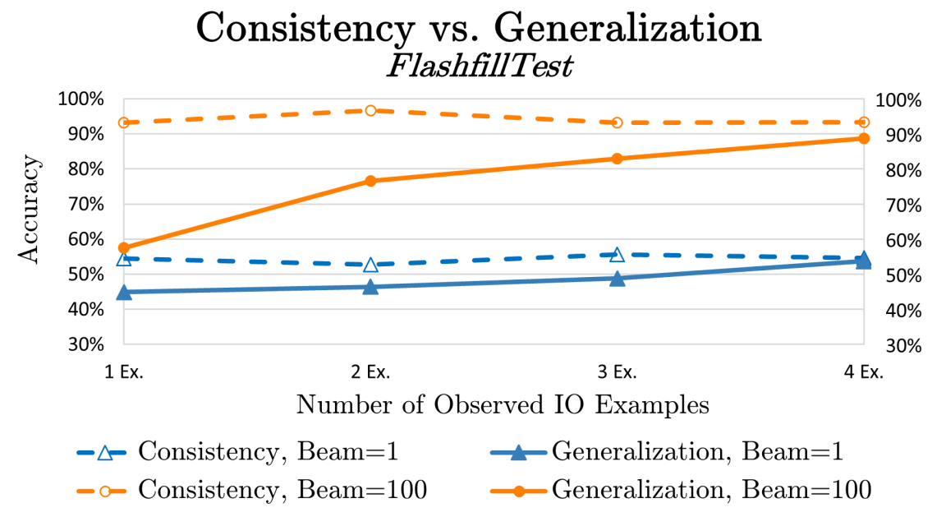
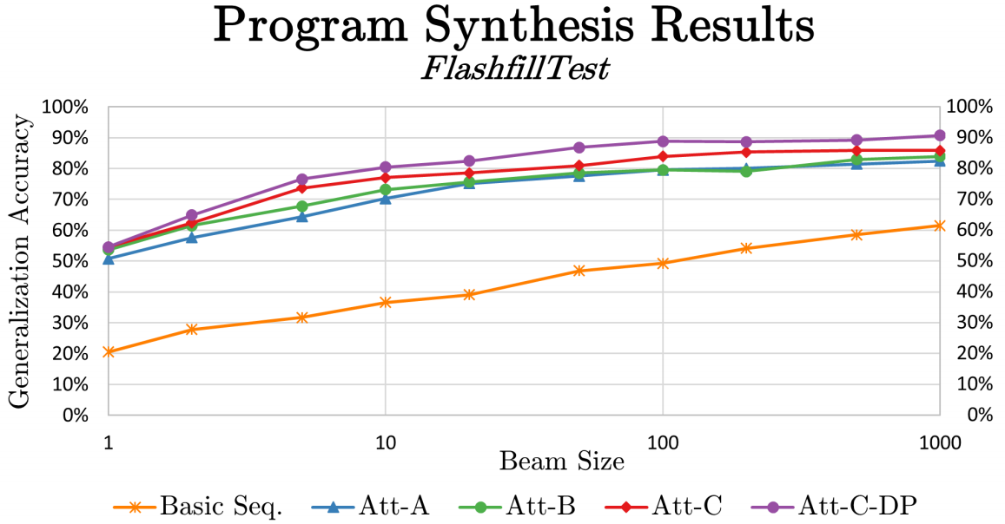
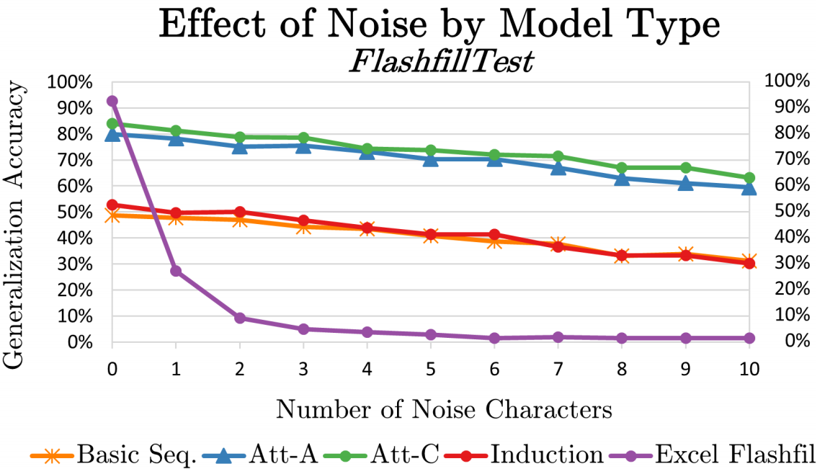
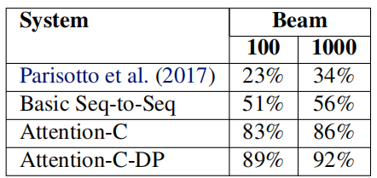
Results
Notes:
Once training is complete, the synthesis models can be decoded with a beam search decoder.
Unlike a typical sequence generation task, where the model is decoded with a beam k and then only the 1-best output is taken, here all k-best candidates are executed one-by-one to determine consistency.
If multiple program candidates are consistent with all observed examples, the program with the highest model score is taken as the output.
Generalization accuracy is computed by applying P∗ to all six assessment examples.
The percentage score reported in the figures represents the proportion of test instances for which a consistent program was found and it resulted in the exact correct output for all six assessment examples.
Since the FlashFillTest set does not contain any noisy examples, noise was synthetically injected into the observed examples. All noise was applied with uniform random probability into the InStr or OutStr using character insertions, deletions, or substitutions. Noise is not applied to the assessment examples, as this would make evaluation impossible.
The behavior of Excel FlashFill is quite different. Without noise, it achieves 92% accuracy, matching the best result reported earlier in this paper. However, with just one or two characters of noise, Excel FlashFill is effectively “broken.”
We believe that this robustness to noise is one of the strongest attributes of DNN-based approaches to program synthesis.

Slide 16
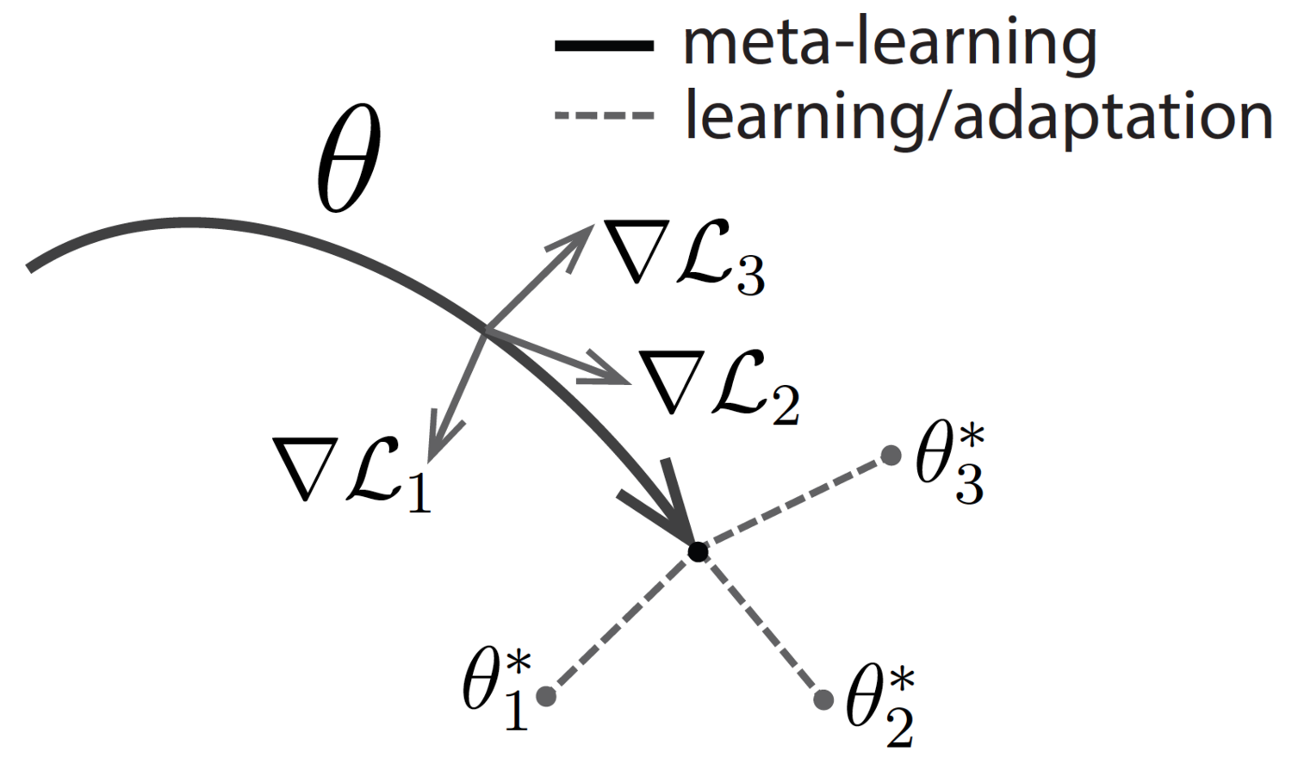
Challenges & Opportunies
Scalability
Need fundamental algorithmic innovation (Meta-optimization, etc.)
Specification
Symbol grounding problem (Harnad, 1990; Mooney, 2008)
Technical need to design “canonical” symbolic requirements
Technical need to solve natural language understanding
Dataset
Build and modify codebases interpretable by humans
Notes:
Perhaps the most immediate challenge in neurosymbolic programming is scalability. Searching over discrete program architectures is a combinatorially hard problem, and despite sustained effort from the program synthesis community, program architectures that can be automatically discovered through search tend to be small. In contrast, end-to-end deep learning now scales to models with hundreds of billions of parameters. We need to refine our methods for representation learning for code structure.
An important question in this kind of specification design is how to align symbolic specifications with representations learned using neural methods. However, it is especially tricky in neurosymbolic programming, where symbolic and neural components can be interleaved in complex ways.
Neurosymbolic programming assumes that one can symbolically specify known facts about the world. However, such specification can be nontrivial. An overly restrictive DSL would prevent the discovery of interesting models. An overly permissive DSL would make search too difficult and also encourage overfitting.

Slide 17
Research Protocol
Retrieval standard
(Keywords+Snowballing)
Paper collection
1 - Organize the papers based on features
2 - Categorize the papers
3 - Perform paper analysis
4 - Propose challenges and opportunities
By task, neural network topology, training method, model performance, etc.
Main steps for semantic modeling
Data efficiency
Extract the major contribution of papers
Representation scalability
Cluster similar papers based on main features
Note down strengths and weaknesses of papers
Evaluation and generalizability

Slide 18
References
Solar-Lezama, Armando et al. “Combinatorial sketching for finite programs.” ASPLOS XII (2006).
Bengio, Yoshua et al. “Representation Learning: A Review and New Perspectives.” IEEE Transactions on Pattern Analysis and Machine Intelligence 35 (2013): 1798-1828.
Smolensky, Paul. “Connectionist AI, symbolic AI, and the brain.” Artificial Intelligence Review 1 (2004): 95-109.
Sarker, Md. Kamruzzaman et al. “Neuro-symbolic artificial intelligence.” AI Commun. 34 (2021): 197-209.
Parisotto, Emilio et al. “Neuro-Symbolic Program Synthesis.” ArXiv abs/1611.01855 (2017): n. pag.
Devlin, Jacob et al. “RobustFill: Neural Program Learning under Noisy I/O.” ICML (2017).
Hopfield, John J.. “Neural networks and physical systems with emergent collective computational abilities.” Proceedings of the National Academy of Sciences of the United States of America 79 8 (1982): 2554-8 .
Garson, James. The Stanford Encyclopedia of Philosophy. Metaphysics Research Lab, Stanford University.
Chaudhuri, Swarat et al. “Neurosymbolic Programming.” Found. Trends Program. Lang. 7 (2021): 158-243.
Dang-Nhu, Raphaël. “PLANS: Neuro-Symbolic Program Learning from Videos.” NeurIPS (2020).
Valkov, Lazar et al. “HOUDINI: Lifelong Learning as Program Synthesis.” NeurIPS (2018).
Devlin, Jacob et al. “Semantic Code Repair using Neuro-Symbolic Transformation Networks.” ArXiv abs/1710.11054 (2017): n. pag.
Mitchell, Tom (1997). Machine Learning. New York: McGraw Hill. ISBN 0-07-042807-7. OCLC 36417892.
Murali, Vijayaraghavan et al. “Neural Sketch Learning for Conditional Program Generation.” ICLR (2018).
Singh, Rishabh and Sumit Gulwani. “Predicting a Correct Program in Programming by Example.” CAV (2015).
Lemaréchal, C. (2012). "Cauchy and the Gradient Method" (PDF). Doc Math Extra: 251–254.
Goodfellow, Ian; Bengio, Yoshua; Courville, Aaron (2016). "6.5 Back-Propagation and Other Differentiation Algorithms". Deep Learning. MIT Press. pp. 200–220. ISBN 9780262035613.
Vaswani, Ashish; Shazeer, Noam; Parmar, Niki; Uszkoreit, Jakob; Jones, Llion; Gomez, Aidan N.; Kaiser, Lukasz; Polosukhin, Illia (2017-12-05). "Attention Is All You Need".
Finn, Chelsea et al. “Model-Agnostic Meta-Learning for Fast Adaptation of Deep Networks.” ICML (2017).

Slide 19
